Slide 1
PBL Residency
Summer 2022

Slide 2
Introduction
Todd Bakker
Entrepreneurship 12- Abbotsford Christian School
PBL stream

Slide 3
Goals as a Learner for the week
I was really hoping to nail down something that could be of use in my entrepreneurship class.
I'm excited, but also anxious for the course.
Be inspired by other examples of PBL.
See more secondary Science example of PBL.

Slide 4
Project Description
In this project, students in Entrepreneurship 11/12 will be designing a small business that provides a service, creates a product or plans an event. We will be meeting with many local entrepreneurs throughout the project. Students will work through building an action plan over the course of many weeks and will learn the competencies in the course through the context of their project. After approximately 2-3 months (in a linear course) of developing their business, they will be asked to perform a Dragon's Den type presentation in front of an authentic audience (professionals who have previously communicated with the class) The group will vote on 1-3 of the projects (depending on class size) that they will move forward with it in the second half of the course. A date will be set for any major events to complete the project in a timely fashion. All proceeds from the events/products and services will be donated to the NPO that was decided on by the student group near the beginning of the course.

Slide 5
Entrepreneurs for a Cause
Driving question: How can we design events/good/services that produce profit for a local NPO?

Slide 6
Voice and Choice
Students will find voice and choice in the following ways...
What kind of business they would like to create
Which professionals they will contact to conduct market research
Which NPO they will be supporting
Which project they will join post Dragon's Den cut-off

Slide 7
Authenticity
Students will experience authenticity in the following ways...
Hearing the stories of real entrepreneurs in our community
Identifying needs in the Abbotsford community (Gathering Markit)
As 2+ of the projects will be carried out, students will all prepare in a fashion as if they will be starting their business

Slide 8
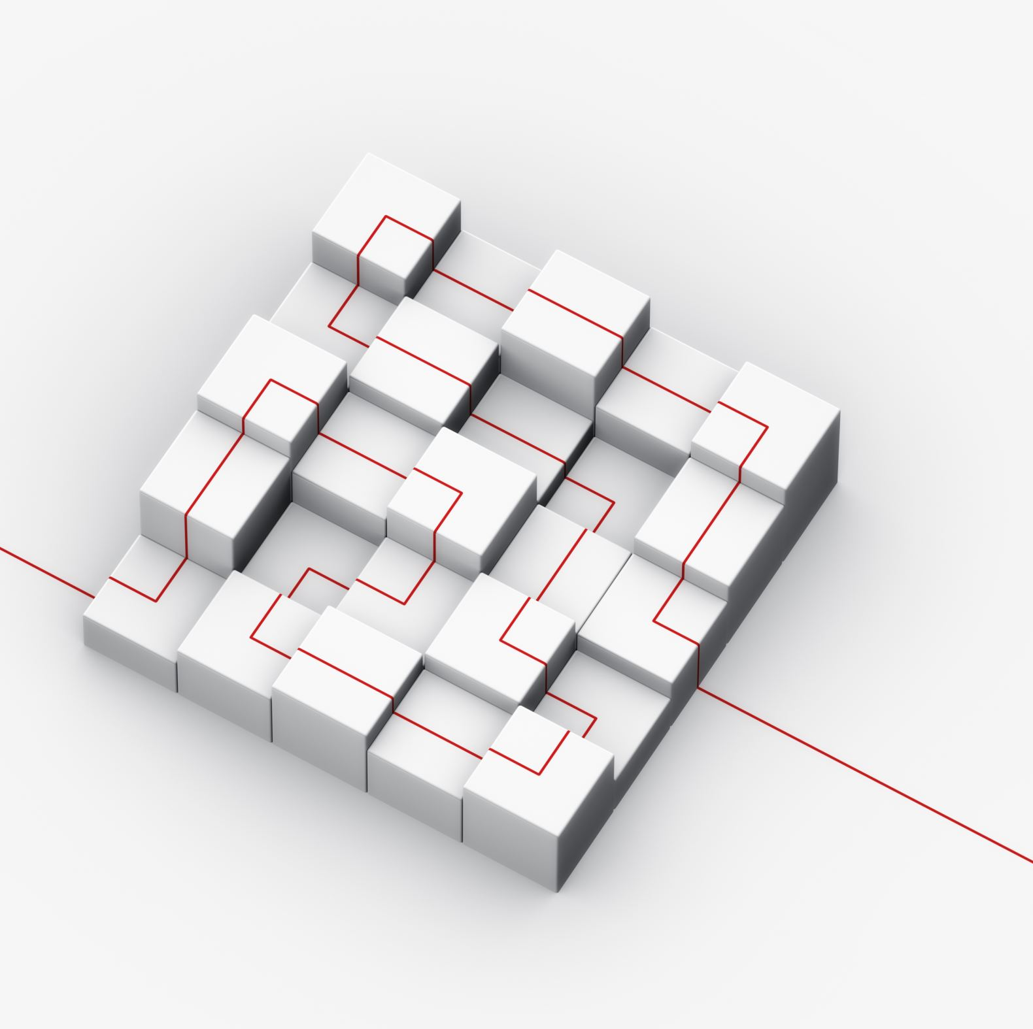
Sustained Inquiry
The market plan (meat of the project) will require sustained inquiry as the students move through the 7-10 steps involved in creating a business plan.
Example- Strength Assessment, Ideation, Market Research, Market Share, Site, Production Plan, Marketing plan, etc...

Slide 9
Critique and Revision
Various protocols throughout the course.
During each step of the market plan, students will have the opportunity to present their ideas and receive feedback from classmates/teachers/professionals in industry.
Critique will be essential in avoiding my biggest fears (bake sale, fundraiser in school community, etc.)
I'm hoping to meet with all students individually throughout the course (at least once per month)

Slide 10
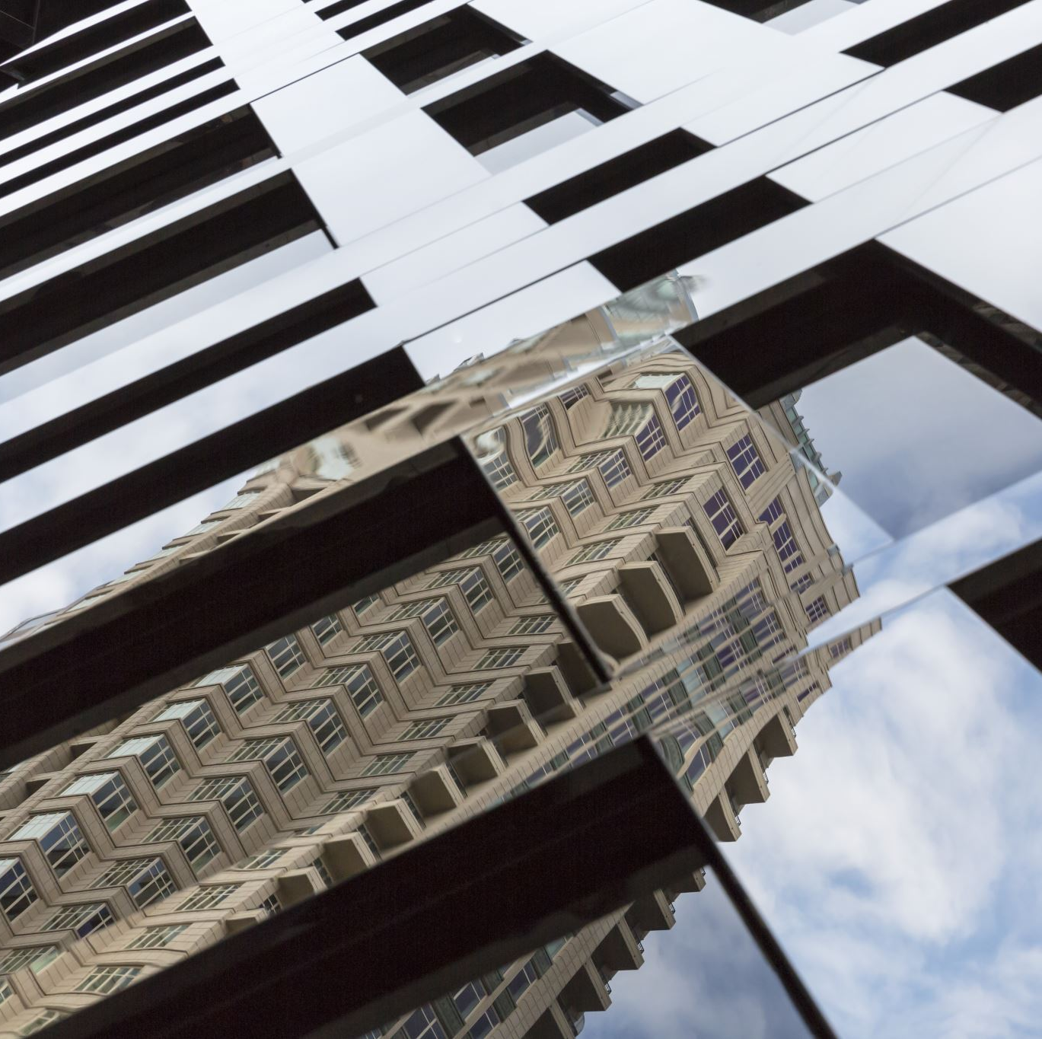
Reflection
As often as possible...
I'm terrible at this so I'm building it into the calendar to make sure it happens.
Taking time to grab quoteables if this ever becomes a presentation I will have to give to others.

Slide 11
So What?
I'm excited to have a course that runs as a project.
I've done this once before and I fell in love with it.
This will be a challenge for students, but I hope that they will experience a) the challenges of becoming an entrepreneur b) the emotions that go along with a business venture and c) The risk-taking element of entrepreneurship
Hoping that working alongside NPO's will change their perspective on business (hard balance between paying the bills and lving into God's story)

Slide 12
Now WHAT?
Next Steps:
- Lining up all the field trips (want to enlarge my black book)
- Outside admin to come in and check on the projects and provide feedback
Support:
- Figuring out exactly what this course is going to look like
- Making sure it is sustainable for the future
Feedback:
- Nervous for the potential of failure (bake sale)

